Slide 1


CITS1003 Introduction to Cybersecurity Exam Example Question
Dr David Glance

Slide 2
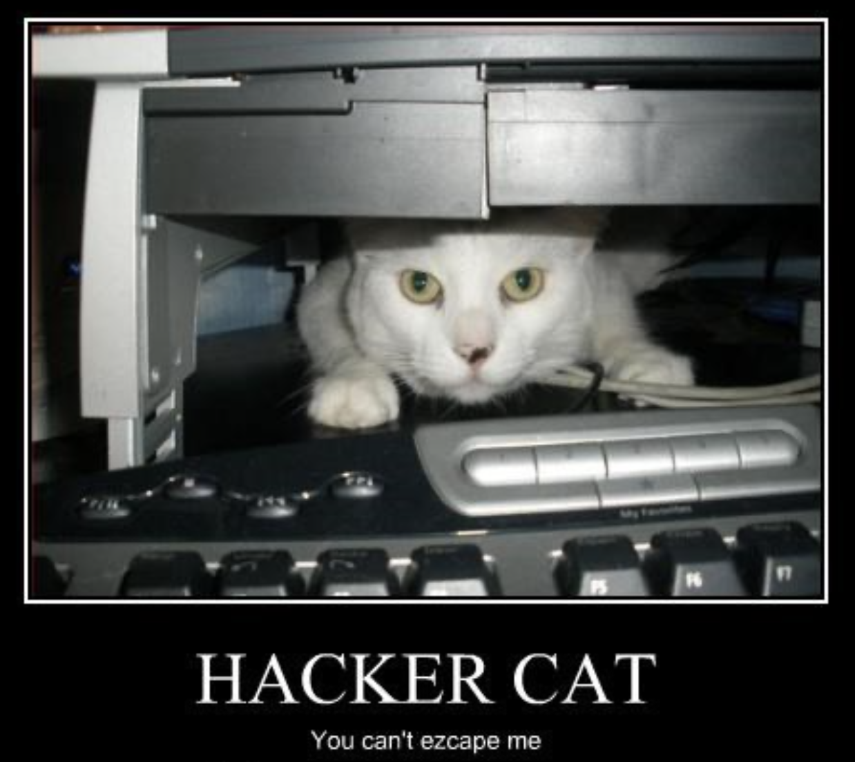
A unit about cats cybersecurity

Slide 3

3 Things
Understand the format of a question
01
Understand how to go about analysing the question
02
Understand how to answer the question
03

Slide 4
Exam Format
5 questions with 2-3 parts to each
Exam total points: 100
Exam lasts 2 hours
Worth 50% of unit marks
Closed book
Each question indicates the amount of time you should spend on each question

Slide 5
Example Question
A Swedish hacker, Lisbeth Salander, has found a zero day in Windows 11. She wants to communicate it to Satya Nadella (CEO of Microsoft) directly via PGP (a public key encryption program). Nadella has never met Salander and has never used open source software before and has downloaded PGP.
Both Salander and Nadella know journalist Stephen Levy. Salander has the correct keys for Levy.

Slide 6
Example Question (continued…)
Using your knowledge of public key encryption, describe a sequence of messages to get Salander the key she needs to communicate with Nadella. When answering, consider:
[1] What key did Salander need to communicate with Nadella? [2] How could Salander trust that she had the correct key from Nadella?
In all these communications, Salander wanted all communications to be encrypted and to be sure that people could trust the sender's identity.
[3] Describe how Salander, Levy and Nadella could know with certainty that the sender of an email was the person they claimed to be?

Slide 7
Answer Background
The question is referring to public key encryption where every participant has a public and a private key
Encryption requires:
the sender to use the receiver’s public key to encrypt the message
the receiver to use their private key to decrypt the message
Digital signatures, that can be used to provide proof of identity requires
the sender to use their private key to sign the message
the receiver checks the identity of the sender by using the sender’s public key
For this to work, the sender and receiver need trusted copies of each other’s public keys which they can get using a web of trust if they have never met each other face-to-face

Slide 8

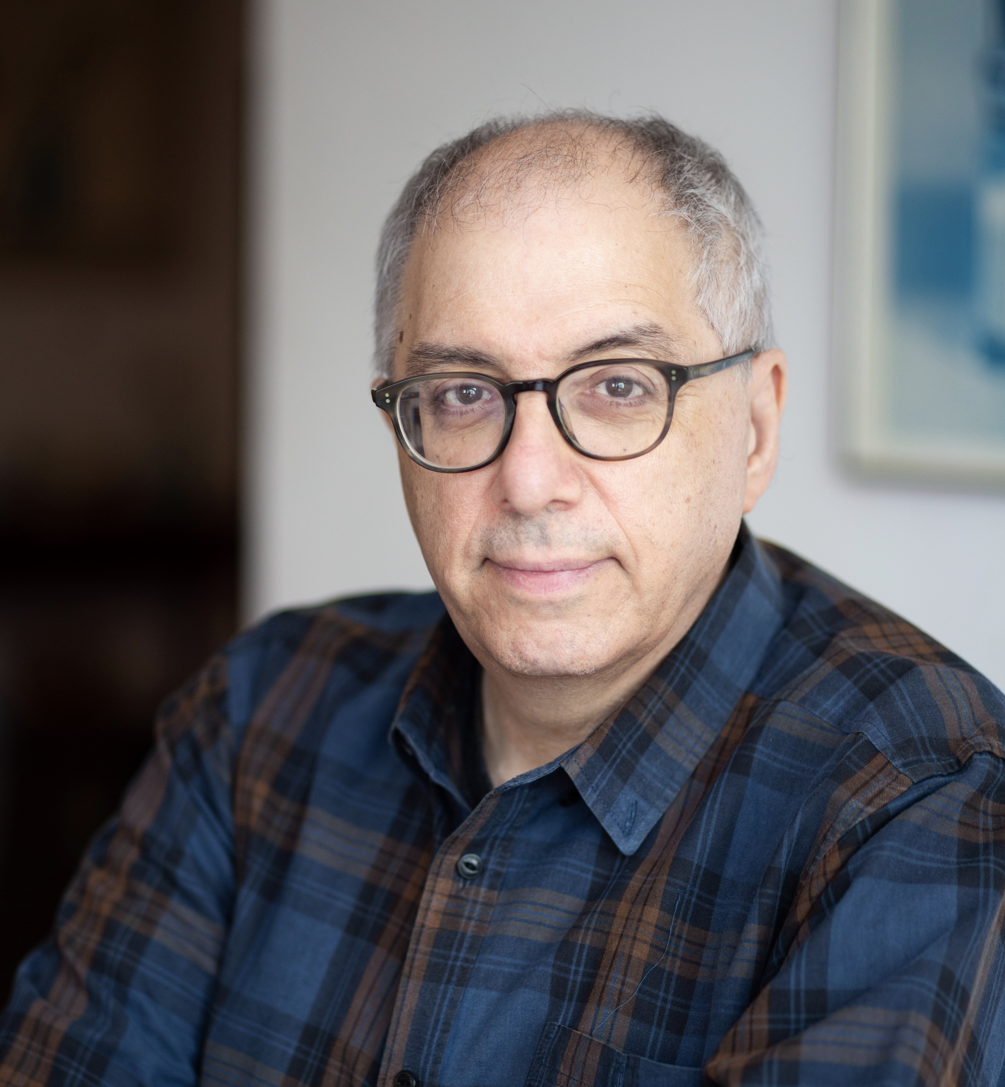
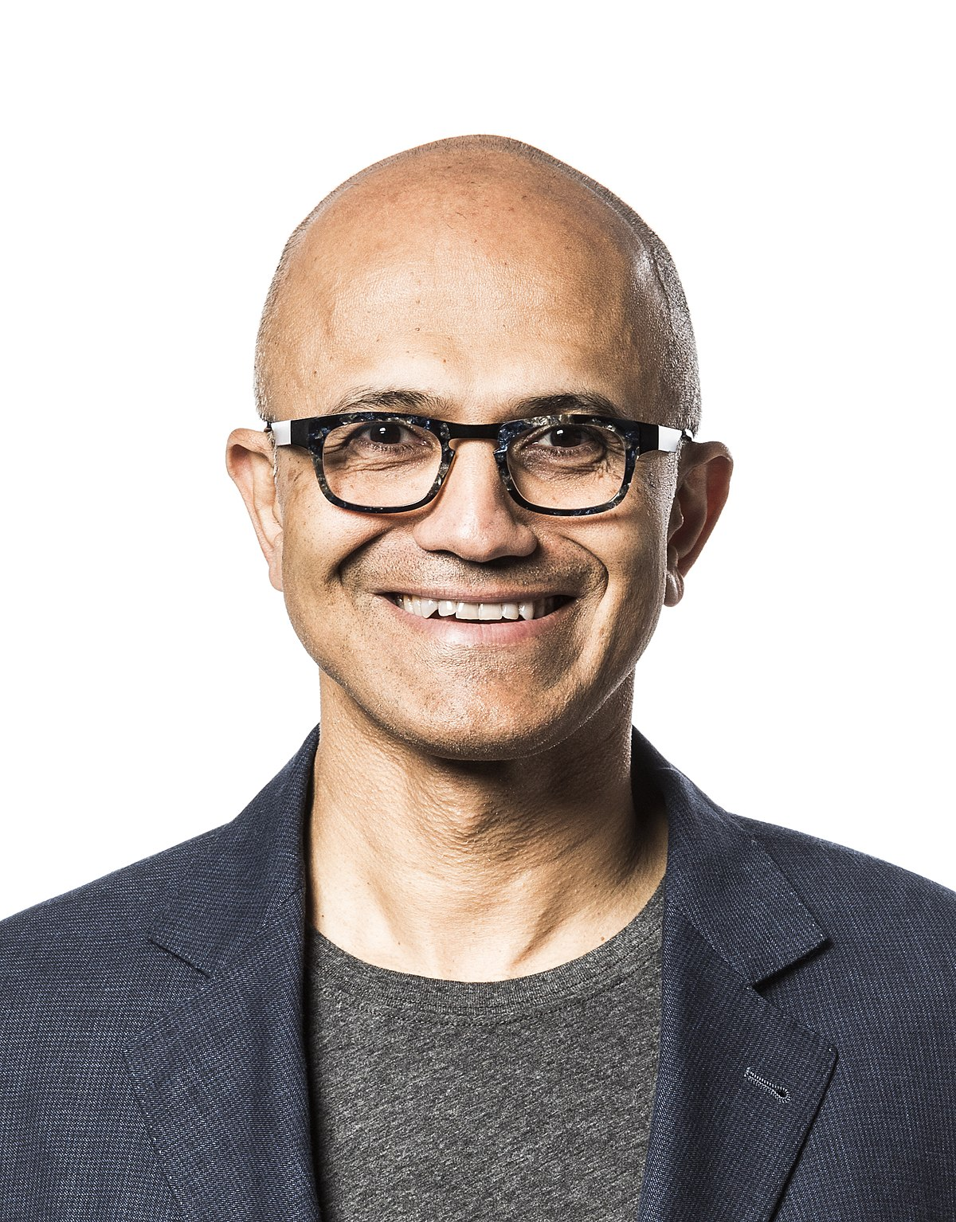
Keys at Start
Salander’s private key
Levy’s private key
Nadella’s private key
Salander’s public key
Levy’s public key
Nadella’s public key
Levy’s public key
Salander’s public key
Levy’s public key
Nadella’s public key

Slide 9
Keys at End
Salander’s private key
Levy’s private key
Nadella’s private key
Salander’s public key
Levy’s public key
Nadella’s public key
Levy’s public key
Salander’s public key
Levy’s public key
Nadella’s public key
Nadella’s public key
Salander’s public key

Slide 10
Answer
Salander sends a signed and encrypted message to Levy asking for Nadella’s public key and requesting that he give Nadella her public key
Message is signed using Salander’s private key and encrypted using Levy’s public key
Levy decrypts the message using his private key and checks the signature using Salander’s public key
Levy responds with a signed and encrypted message including Nadella’s public key
Message is signed using Levy’s private key and encrypted using Salander’s public key
Salander decrypts the message using her private key and checks the signature using Levy’s public key
Levy sends a signed and encrypted message to Nadella including Salander’s public key
Message is signed using Levy’s private key and encrypted using Nadella’s public key
Nadella decrypts the message using his private key and checks the signature using Levy’s public key

Slide 11
Answer
What key did Salander need to communicate with Nadella?
Salander needed Nadella’s public key. Nadella needed Salandar’s public key
How could she trust that she had the correct key from Nadella?
Using the principles of the Web of Trust, Salander trusted Levy and had Levy’s public key. She trusted Levy to vouch for Nadella’s key. Ideally, Levy would have got Nadella’s public key in person
In all these communications, Salander wanted all communications to be encrypted and to be sure that people could trust the sender's identity. Describe how Salander, Levy and Nadella could know with certainty that the sender of an email was the person they claimed to be?
By using digital signatures, they all could verify that the person sending the message was who they claimed to be. This worked because they had verified the public keys that could be used to check the digital signatures of the messages.

